Slide 1
Semantic Mapping using YOLOv8, WLAN, GPS
Supervisor: Prof. Rahul Mishra
Co-Supervisor: Prof. Tapas Kumar Maiti
Prepared By: Jigar Shekhat - 202211004

Slide 2
Contents
Introduction
Motivation
Background
Problem Statement
Objective
Work
Data Collection
Dataset
Result
Conclusion and Future Work
References

Slide 3
Introduction
Semantic mapping is a powerful concept that enhances traditional indoor mapping by adding a layer of semantic understanding to the physical layout of spaces like objects, GPS signal and WiFi.
It is a sophisticated concept that requires accurate object detection and understanding of spatial relationships.

Slide 4
Motivation
Indoor localization has evolved from an advantage to an essential element in the quickly developing field of smart environments.
Precise Navigation
Dynamic Environment Adaptation
Localization Accuracy
Problems :
These issues can be solved by adding semantic mapping, resulting in efficient navigation, contextual understanding, task execution, environment adaption, autonomy, adaptability, and accurate localisation.

Slide 5
Background
Recent advances in indoor localization methods that use spatial context to improve the location estimation. [1]
Semantic localization dataset for indoor environments named ViDRILO. The dataset provides five sequences of frames acquired with a mobile robot in two similar office buildings under different lighting conditions. [2]
Accurate Localization which enables the robot to include other types of observations in the classification, like camera images.[3]
Smart Buildings and IoT Integration
Augmented Reality Navigation
Robotics and Automation
[ Real-time Use ]

Slide 6
Problem Statement
How to achieve accurate semantic mapping with dynamic environment adaptation for easier navigation and localization in indoor ?

Slide 7
Objective
Our objective is to utilize semantic mapping to enhance place classification performance by using information about objects, WiFi and GPS data.

Slide 8
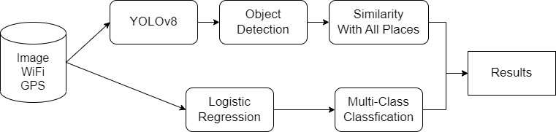
Workflow
[ fig1: Workflow]

Slide 9

YOLOv8
Real-time object detection and image segmentation model
YOLOv8 models for object detection ship already pre-trained on the COCO dataset, which is a huge collection of images of 80 different types
Annotation: It typically include the coordinates of the bounding boxes, as well as the class label associated with each object.

Slide 10
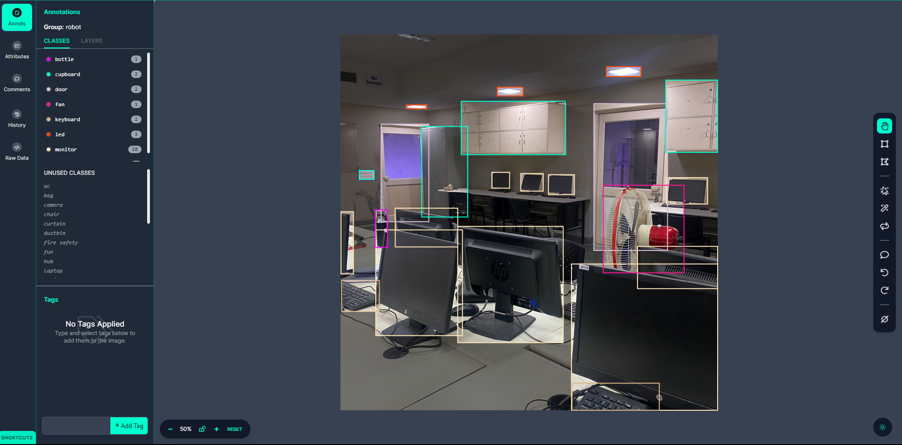
Custom Object Detection
[ fig2:Labeling ]

Slide 11

WiFi
WiFi networks emit radio waves at specific frequencies.
By analyzing the distribution of WiFi signal strengths across an indoor space, it’s possible to gain insights about Environment.
WiFi signals interact with walls, furniture, and other objects, leading to variations in signal strength across different locations.
Notes:
into the spatial characteristics of the environment, including signal attenuation, interference, and the presence of obstacles.

Slide 12

GPS
Global Positioning System (GPS) signals, originally designed for outdoor navigation, can still provide valuable context for indoor localization projects, despite their limitations within enclosed spaces.
Problems:
Weak Signals
Multipath Effects
Coarse Accuracy
Notes:
=> GPS signals weaken and experience multipath effects indoors due to signal attenuation caused by walls and structures, they can still contribute to indoor localization in certain scenarios.

Slide 13
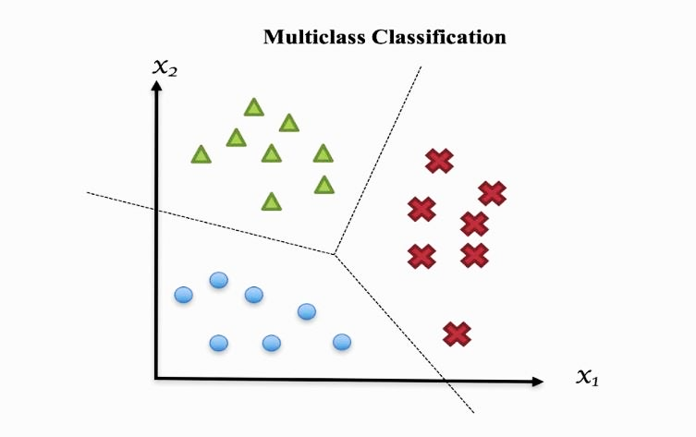
Logistic Regression
Binary Classification Task.
Training Multiple Classifiers(One-vs-All): For each room in your dataset, train a separate Logistic Regression classifier each focusing on distinguishing a particular room.
When predicting the room for a given WiFi and GPS data point, We run the input through each of the trained classifiers. The classifier with the highest predicted probability indicates the most likely room.

Slide 14
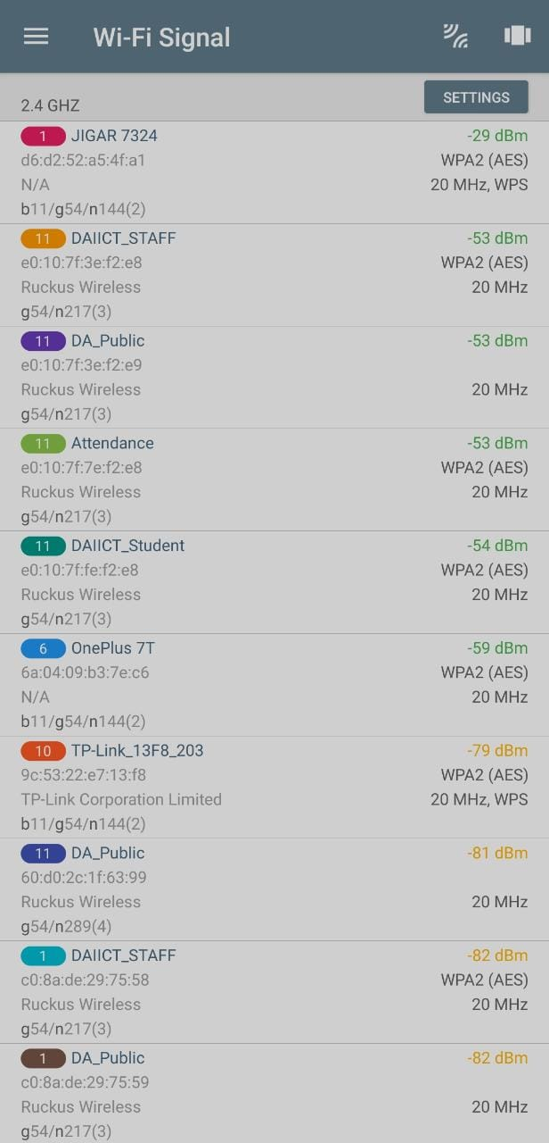
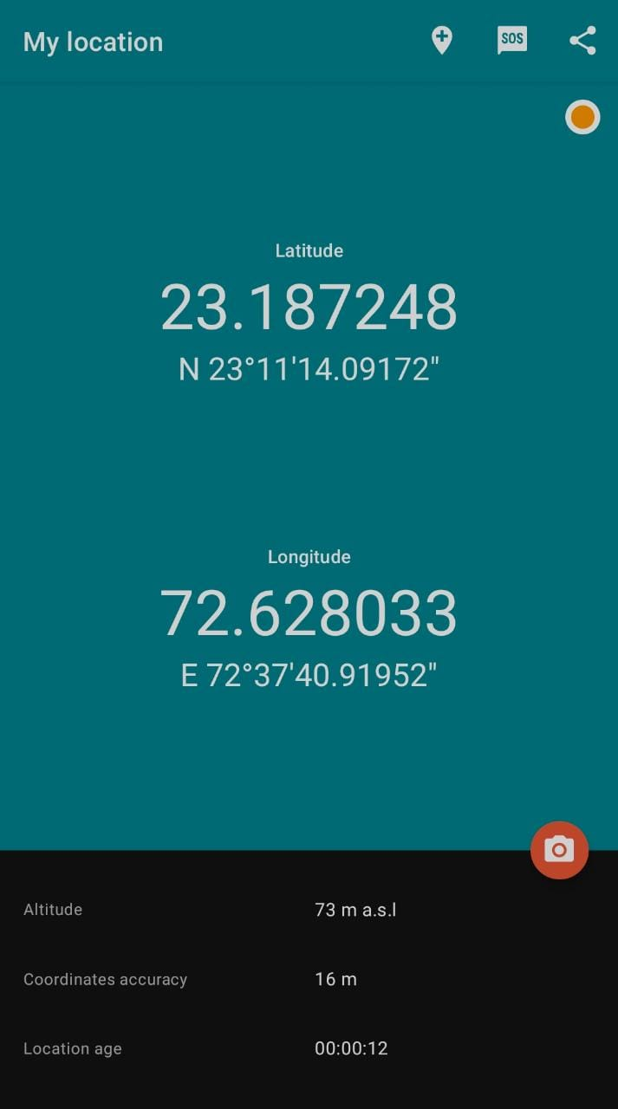
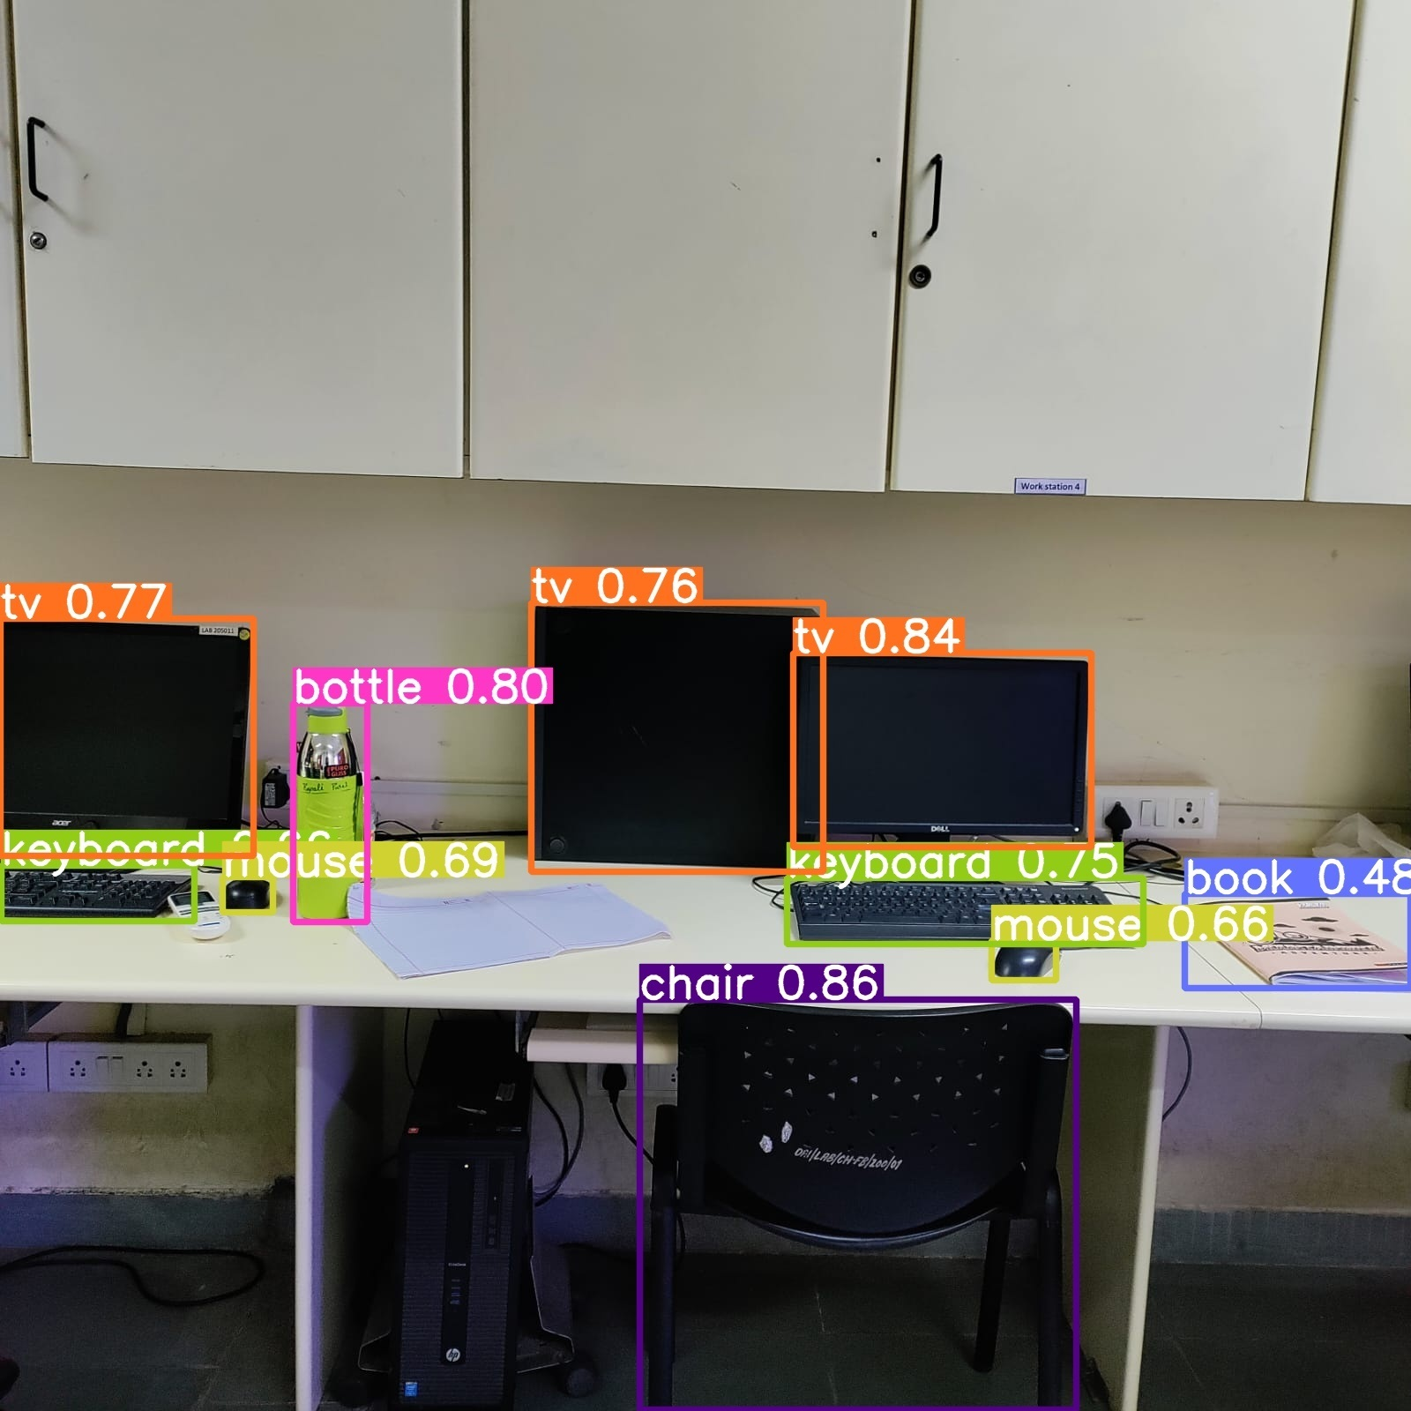
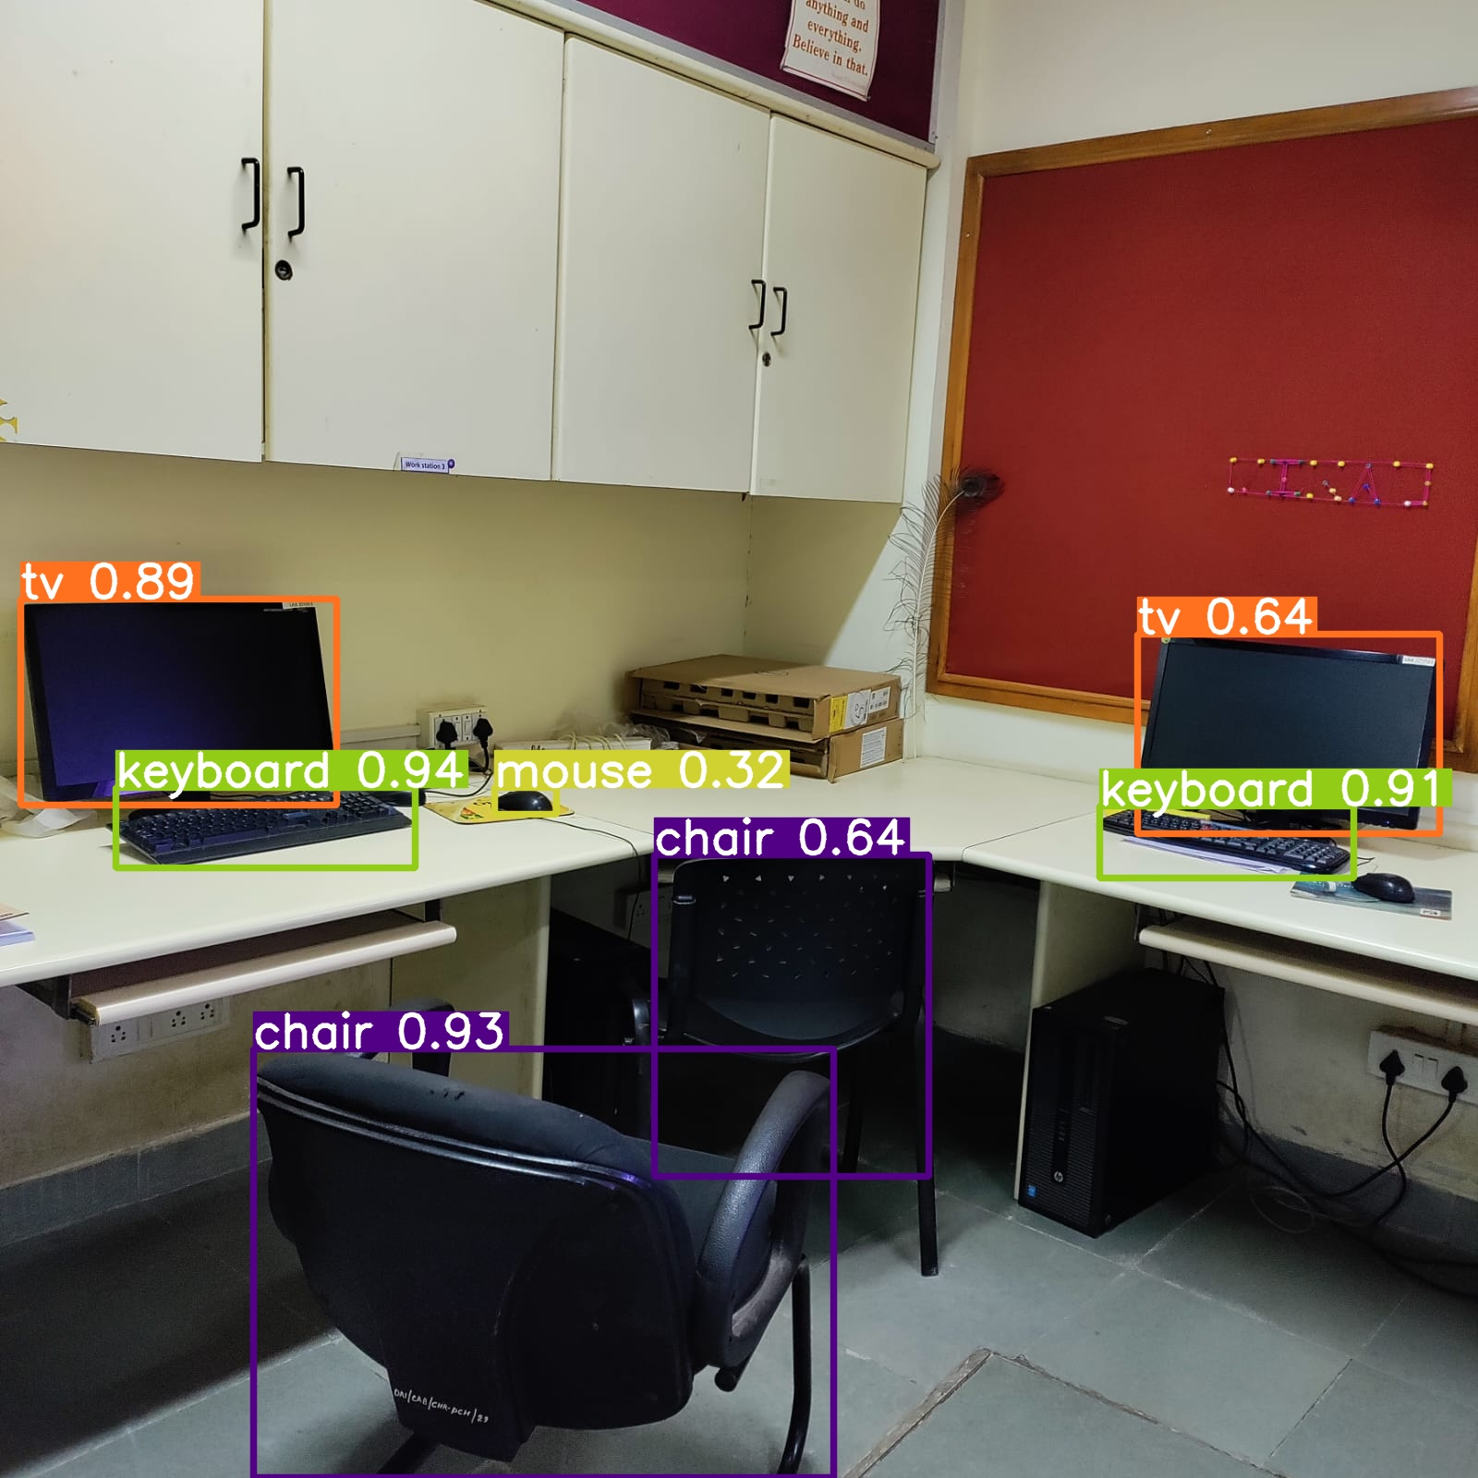
Data Collection
[ fig3:YOLOv8 Object Detection ]
[ fig4:WiFi Data ]
[ fig5:GPS data ]

Slide 15
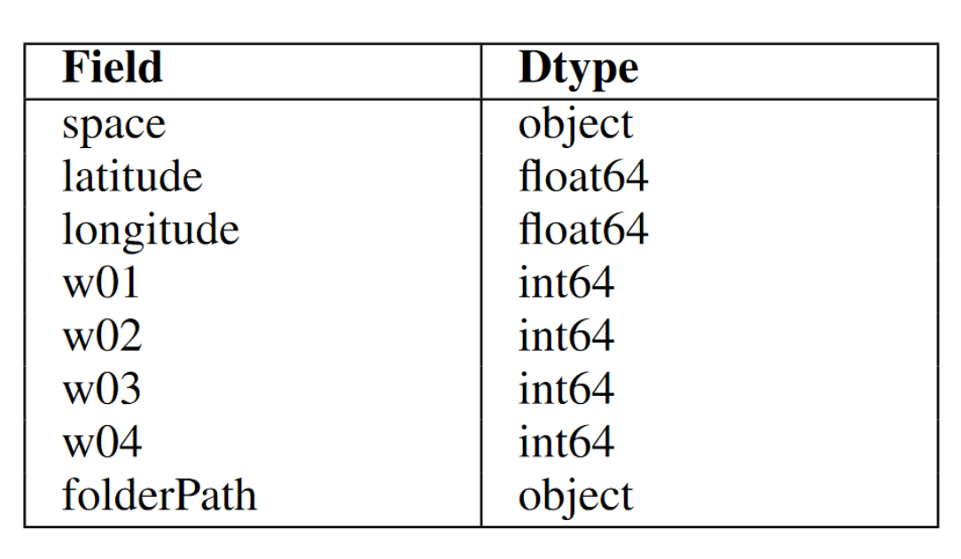
Dataset
GPS :
WiFi :
Images :
[ fig6:Schema ]

Slide 16
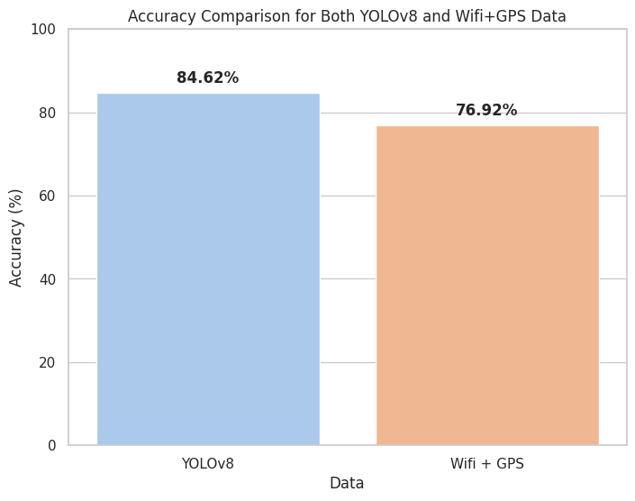
Results
[ fig7:Comparison ]

Slide 17
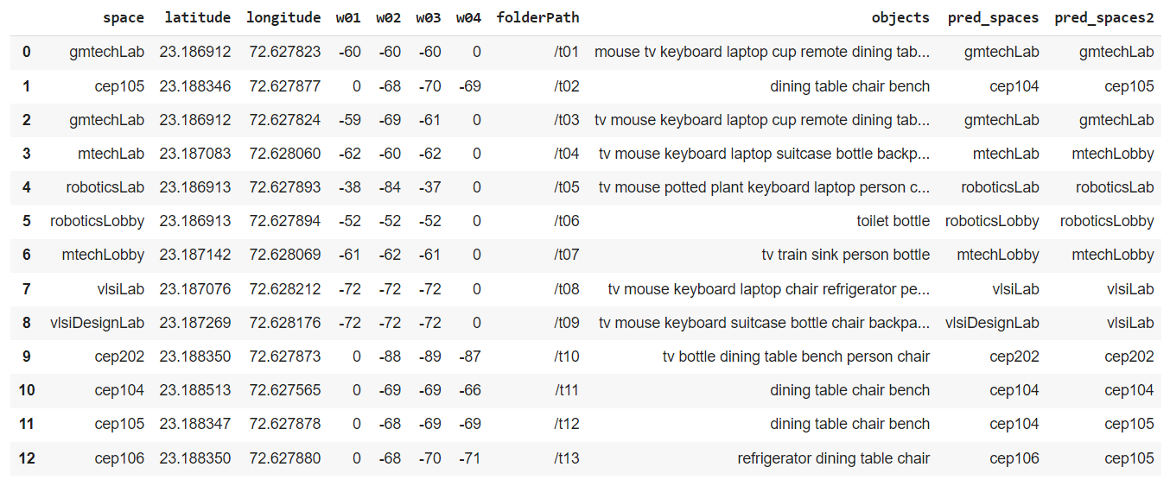
Results
[ fig8:Result Table ]

Slide 18
Conclusion
We extract the conclusion from this project that utilizing wifi and GPS data along with room images can produce results that are more precise.
However, YOLOv8 frequently misdetects objects, and GPS signal is frequently unable to penetrate buildings.
Future Work
Data Collection
Handling Dynamic and Undefined Objects
Extension to Whole Floor or Building Detection
Semantic Object Relationships

Slide 19
References
Gu, F., Hu, X., Ramezani, M., Acharya, D., Khoshelham, K., Valaee, S. and Shang, J., 2019. Indoor localization improved by spatial context—A survey. ACM Computing Surveys (CSUR), 52(3), pp.1-35.
Martínez-Gómez, J., García-Varea, I., Cazorla, M. and Morell, V., 2015. Vidrilo: The visual and depth robot indoor localization with objects information dataset. The International Journal of Robotics Research, 34(14), pp.1681-1687.
Mozos, Ó.M. and âOscar Martâinez Mozos, 2010. Semantic labeling of places with mobile robots (Vol. 61). Berlin/Heidelberg, Germany: Springer.
Uygur, I., Miyagusuku, R., Pathak, S., Moro, A., Yamashita, A. and Asama, H., 2020. Robust and efficient indoor localization using sparse semantic information from a spherical camera. Sensors, 20(15), p.4128.
Lymberopoulos, D. and Liu, J., 2017. The microsoft indoor localization competition: Experiences and lessons learned. IEEE Signal Processing Magazine, 34(5), pp.125-140.
Juan Terven and Diana Cordova-Esparza. A comprehensive review of yolo: From yolov1 to yolov8 and beyond.arXiv preprint arXiv:2304.00501, 2023
Chien-Yao Wang, Alexey Bochkovskiy, and HongYuan Mark Liao. Yolov7: Trainable bag-of-freebies sets new state-of-the-art for real-time object detectors. In Proceedings of the IEEE/CVF Conference on Computer Vision and Pattern Recognition, pages 7464–7475, 2023.

Slide 20
Thank You…!

